Slide 1

Analysing financial credit/debit card data and online bank transactions
By Sabah, Eirini, and Ozioma

Slide 2
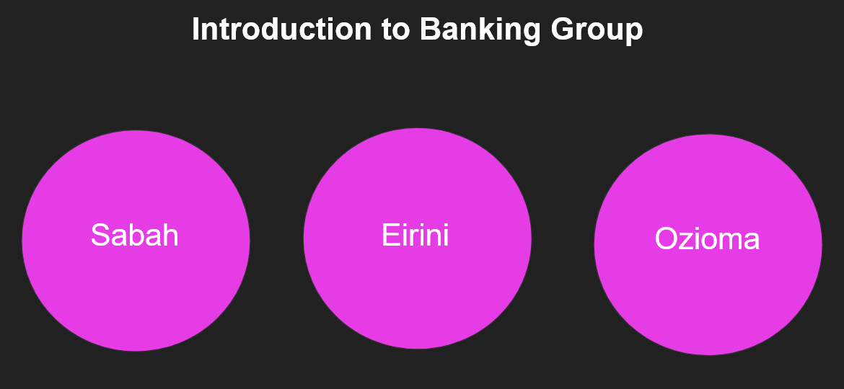

Slide 3
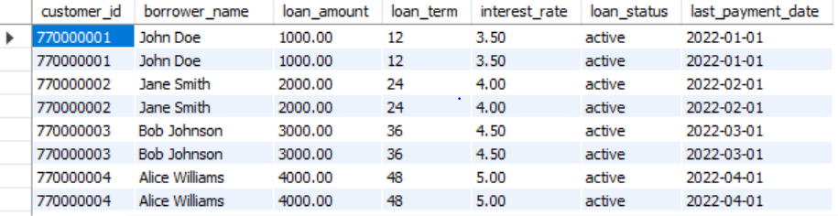
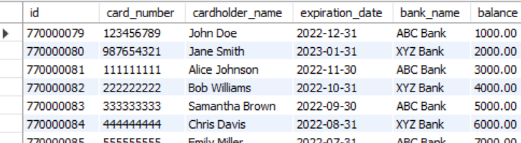
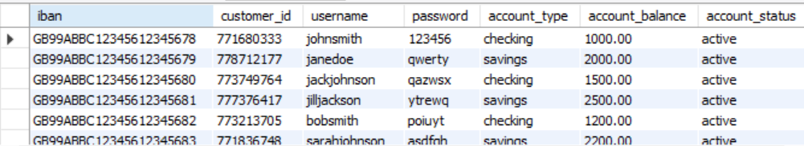
1st Database: credit_card_data with the following tables:
customer Columns: cust_id, nin, first_name, last_name, country_id, country_name
country
Columns: country_id, country_name
Card type
Columns: card_type_id, card_type_name
Card transaction
Columns: transaction_id, transaction_date, transaction_amount
Card number
Columns: card_id, customer_id, card_type_id
Do we have primary and foreign keys here?
Tables
Bank loans
Debit Cards
Online Banking

Slide 4
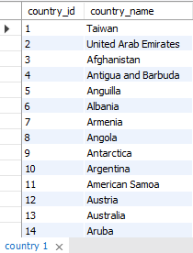
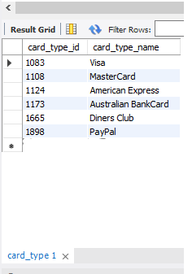
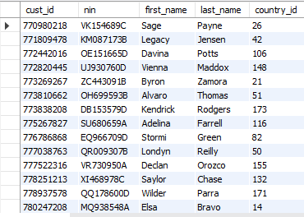
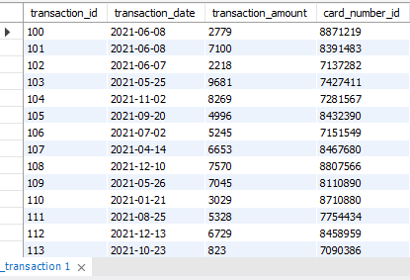
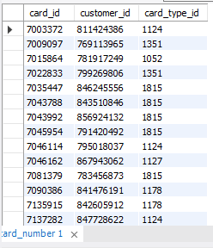
Bank loans
2nd Database: credit_card_data with the following tables:
Country Columns: country_id (Primary Key), country_name
Card type
Columns: card_type_id (PK), card_type_name
Customer
Columns: cust_id (PK), nin, first_name, last_name, country_id
Card transaction
Columns: transaction_id (PK), transaction_date, transaction_amount, card_number_id
Card number
Columns: card_id (PK), customer_id (FK referencing the table Customer), (FK referencing the table Card_type).
card_type_id

Slide 5
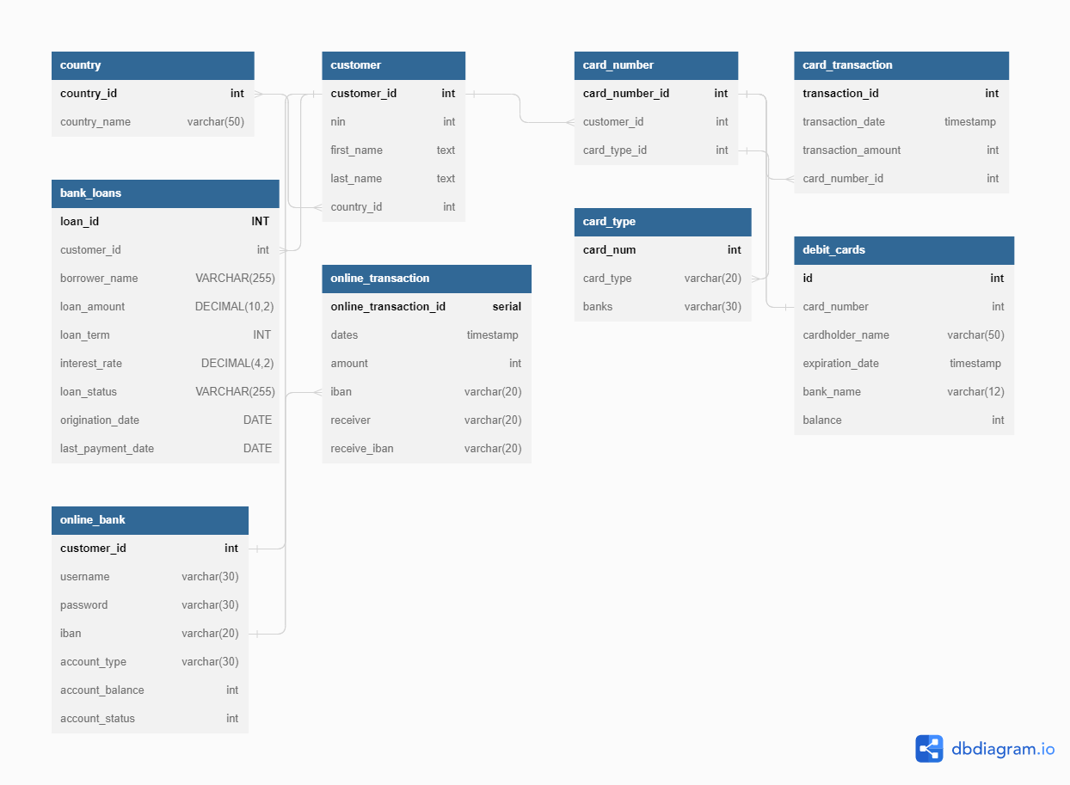
DB Diagram

Slide 6
Code used -reason: Stored Function Calculate the total account balance after what event?
CREATE PROCEDURE total_account_balance()
BEGIN
SELECT SUM(account_balance)
FROM online_banking;
END
CALL total_card_balance();

Slide 7
Stored procedure: We use it to find what exactly?
CREATE PROCEDURE debitCardProcedure
@cardNumber char(16),
@cardholderName varchar(255),
@expirationDate date,
@currentBalance decimal(10,2)
AS
BEGIN
INSERT INTO DebitCards(cardNumber, cardholderName, expirationDate, currentBalance)
VALUES(@cardNumber, @cardholderName, @expirationDate, @currentBalance)
END
EXEC debitCardProcedure @cardNumber = '1234567812345678',
@cardholderName = 'John Doe',
@expirationDate = '2022-12-31',
@currentBalance = 100.00

Slide 8
Views (joins, query &subquery) We use it to achieve what?
CREATE VIEW card_History AS
SELECT Customers.firstname,Customers.lastname,card_transaction.trans_amount,
card_transaction.trans_date, card_type.card_types
FROM customer inner join card_transaction
on(Customer.customer_id = Card_number.customer_id)
inner join card_transaction
on(card_transaction.card_id = card_number.card_id);

Slide 9
Trigger In this example, the trigger is named debit_card_limit and is associated with the debit_card_table. The trigger is set to activate AFTER a new row is INSERTed into the table. When the trigger is activated, it checks the amount value in the new row. If the amount is greater than 25,000, it raises an error stating that the debit card limit has been exceeded.
CREATE TRIGGER debit_card_limit
AFTER INSERT ON debit_card_table
FOR EACH ROW
BEGIN
IF (NEW.amount > 25000) THEN
RAISEERROR('Debit card limit exceeded.');
END IF;
END;

Slide 10
Event This event will be triggered every day, and will send an email to each new customer that is added to the online_banking table. Of course, you can customize the event to suit your specific needs, such as changing the schedule or the email message that is sent.
CREATE EVENT new_customer_event ON SCHEDULE EVERY 1 DAY DO BEGIN
-- Send an email to the new customer with their login information
SEND EMAIL TO customer.email SUBJECT 'Your online banking account has been created' MESSAGE 'Dear customer, Your online banking account has been created. Your username is customer.username and your password is customer.password. Thank you for choosing our bank for your online banking needs.'; END;

Slide 11
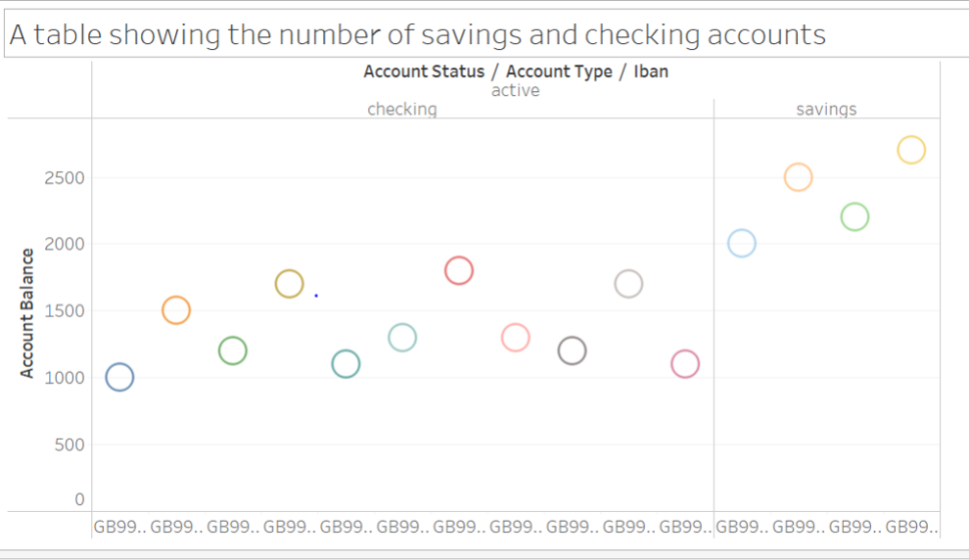
Tableau

Slide 12
Reflections
What we have learned?
Being able to perform a wide range of operations on data stored in a database, including retrieving, inserting, updating, and deleting data.
Difficulties and challenges?
Planning data for several different tables and thinking proactively on where the joins can be
What we would have done if we had more time?
Creating larger datasets and having more time to create more complicated procedures

Slide 13
Thank you for listening!

